Slide 1
Implement Merge sort without using recursion
HRITIK SHARMA (IIT2019020) SHREYANSH PATIDAR (IIT2019018) BISWAJEET DAS (IIT2019019)

Slide 2
Abstract
This Paper contains the algorithm to implement merge sort without using recursion. Two approaches have been taken and we will see the difference in complexity between both.

Slide 3
Contents
Introduction
Algorithm Design
Algorithm Analysis
Values of O(n) for all approaches
Time complexities of all algorithms and comparison b/w all
Conclusion
References

Slide 4
INTRODUCTION
Sorting^{[1]} refers to arranging data in a particular format. Sorting algorithm specifies the way to arrange data in a particular order. Most common orders are in numerical or lexicographical order.
Merge^{[2]} algorithms are a family of algorithms that take multiple sorted lists as input and produce a single list as output, containing all the elements of the inputs lists in sorted order.
This report further contains -
II. Algorithm Design
III. Algorithm Analysis
IV. Result
V. Conclusion
VI. Result

Slide 5
ALGORITHM DESIGN
Part A (Algorithm used for dividing array into smaller parts):
Takes an array,Arr of n elements as input.
Keep on dividing the array into smaller components in iterative way.
As we breakdown we also keep merging the broken arrays in the order of their sizes in power of 2 in sorted fashion.
Thereby the final merge will result in overall the sorted array.

Slide 6
Algorithm 1:
void mergeSort(int arr[], int n)
{
int curr_size;
int left_start;
for (curr_size=1; curr_size<=n-1; curr_size = 2*curr_size)
{
for (left_start=0; left_start<n-1; left_start += 2*curr_size)
{
int mid = min(left_start + curr_size - 1, n-1);
int right_end = min(left_start + 2*curr_size - 1, n-1);
merge(arr, left_start, mid, right_end);
}
}
}

Slide 7
ALGORITHM DESIGN
Part B (Algorithm used for merging Sorted Components):
Approach 1:
Keep merging 2 Sorted Components into 1 using the merge operation of the merge sort algorithm until we end up with 1 single Sorted Component.
Merge Operation for merging 2 Sorted Components using 2 pointer method.
First pointer points to the current element of first array Arr1[l] and Second pointer points to the current element of second array Arr2[r].
While l does not point to end of first array or r does not point to the end of second array , we have 2 possible cases :
If r points to the end of second array or Arr1[l]≤Arr2[r] we append Arr1[l] to Answer array and increment l by 1.
Else we append Arr2[r] to Answer array and increment r by 1.

Slide 8
Algorithm 2:
i = 0; j = 0; k = l;
while (i < n1 && j < n2)
{
if (L[i] <= R[j])
{
arr[k] = L[i]; i++;
}
else
{
arr[k] = R[j]; j++;
}
k++;
}
while (i < n1)arr[k] = L[i],i++,k++;
while (j < n2)arr[k] = R[j],j++,k++;

Slide 9
ALGORITHM DESIGN
Part B (Algorithm used for merging SortedComponents):
Approach 2:
Here first we calculate the maximum element of both the arrays to be maxA and maxB.
Then we find maxALL = maxmaxA, maxB.
Next, we traverse in a for loop from 1 to maxALL and check if current num is present in A or B.
If present then insert it in the merged array as many times as found.

Slide 10
Algorithm 3:
int maxA,maxB,maxAll;
for(i in 0 to nA)
maxA= max(maxA,A[i]);
for(i in 0 to nB)
maxB= max(maxB,B[i]);
maxAll = max(maxA,maxB);
for(i in 1 to maxAll)
{
if(i in A[] or B[])
Insert i in ans_Array;
}

Slide 11
ALGORITHM ANALYSIS
Algorithm 1:
The above described algorithm to divide the array into smaller components takes O(log(n)) complexity in both the best and worst cases.
t_{best}: when n=0, = O(0) = 0 ms
t_{worst}: when n=100 , t_{worst} = O(2.03 * (2))
Algorithm 2:
merges 2 sorted arrays into 1 using 2-pointer technique takes O(n) for each merge operation therefore for k Sorted Components a total of k−1 merge operations would be required. So, this algorithm takes O(log(n)∗k) complexity where n is the size of input array.
t_{best}: when n=0, = O(0) = 0 ms
t_{worst} : when n=100 ,=O(2*10⁴)

Slide 12
ALGORITHM ANALYSIS
Algorithm 3:
Since it is bruteforce and each num is accessed , the total time complexity comes out to be O(log(n)∗maxALL∗(nA+nB)) where nA,nB are the sizes of array A and array B. So, we can conclude that,
Tavg = O(log(n)∗maxALL∗(nA+nB))
Tworst = O((log(n)∗maxALL∗(k)))
Tbest = O(0)

Slide 13
VALUES OF O(N) FOR BOTH ALGORITHMS
S.No | n | Approach 1 | Approach 2
1 | 0 | 0 | 0
2 | 10 | 23.18229029 | 23182.29029
3 | 50 | 196.9300791 | 196930.0791
4 | 100 | 463.6458057 | 463645.8057
5 | 1000 | 6954.687086 | 6954687.086
6 | 10000 | 92729.16115 | 92729161.15

Slide 14
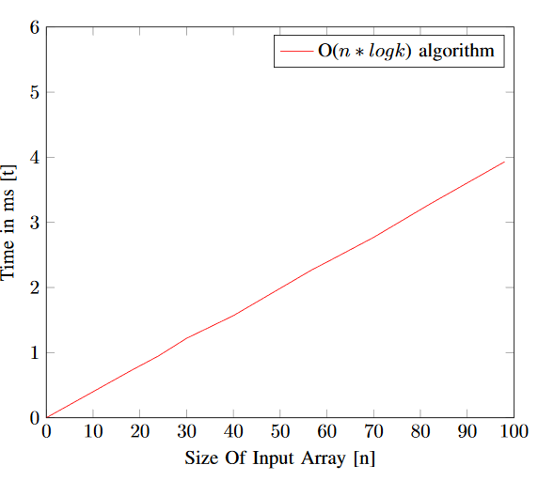
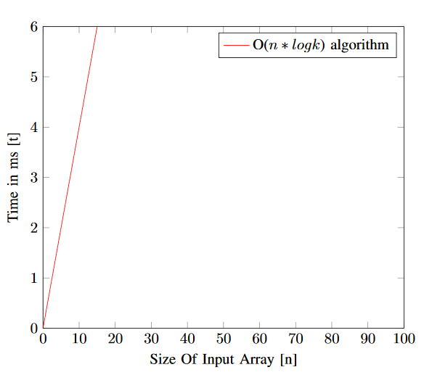
TIME COMPLEXITIES OF ALGO 1 & 2
Algo 1 Time Complexity
Algo 2 Time Complexity

Slide 15
CONCLUSION
Finding sorted components takes same time and space in both the proposed algorithms. But for merging those sorted components, the later approach while using set data structure comes optimal with time complexity O(n∗log k), where n is size of input set/array and k is number of sorted components.So, in worst case too, time complexity would be O(n∗logn).

Slide 16
Reference
[1].https://en.wikipedia.org/wiki/Subsequence
[2]​ https://www.geeksforgeeks.org/longest-increasing-subsequence-dp-3/
[3] ​https://www2.cs.duke.edu/courses/spring18/compsci330/Notes/dynamic.pdf

